Slide 1

Kamala Education Society’s Pratibha College of Commerce & Computer Studies, Chinchwad, Pune-19 Department of B.B.A. (Computer Application) A PROJECT PRESENTATION On “Movie Downloading Website” T.Y.B.B.A. (C.A.) Semester V Under Savitribai Phule Pune University (2022-2023) Developed by:- 10455: Ayaan J Shaikh 10454:Aryan R Saroj

Slide 2
Abstract
Objective:
The main aim of this Just Chill website is online downloading for various movies .
Problem Definition:
Here details about Now downloading movies and no of movies available in a particular website for particular movie, Movie Details.
Existing System:
There are some limitations.
It is scripting language
It is very code complexity
There is server controls in asp

Slide 3
Introduction
The purpose of this document is to present an overall description and listing of the functionality of The Testing Assistant for Regression Testing. It will explain the scope of the project as well as describe the system environment. This document will also include an easily traceable means by which the user can trace each functionality’s brief description to its full description. Also included is a user interface specification whereby the user can demonstrate interface standards to be used in designing the system. Furthermore, considerations regarding non-functional requirements and system evolution are addressed.
The scope of project “Movie World” is to enable the User to select movies and then download the desired movies available at website. Motive of this is to download latest movies and web series for entertainment purpose.

Slide 4
Objectives of The Project
The main objective of the project is to design and develop a user friendly system.
To develop an accurate and flexible system, it will eliminate data redundancy.
Computerization can be helpful as means of saving time & money.
To provide better graphical user interface .
Less chances of information leakage .
Provides security to data by using login & password .

Slide 5
Scope of The Project
The scope of project “Movie World” is to enable the User to select movies and then download the desired movies available at website.
Check availability of movies.
Motive of this is to download latest movies and web series for entertainment purpose.

Slide 6
Web Page Details
REGISTRATION Page
LOGIN Page
Home Page
Downloading and Streaming Page
Contact us Page
Register Backend
Contact Backend

Slide 7
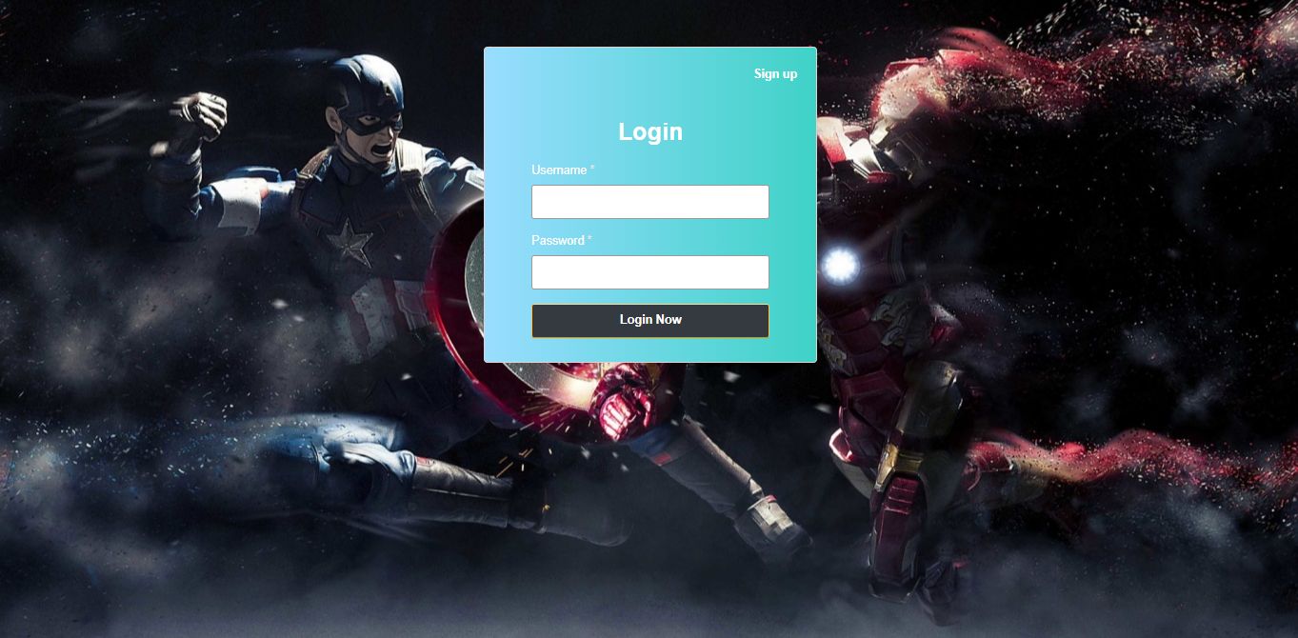
Login Page

Slide 8
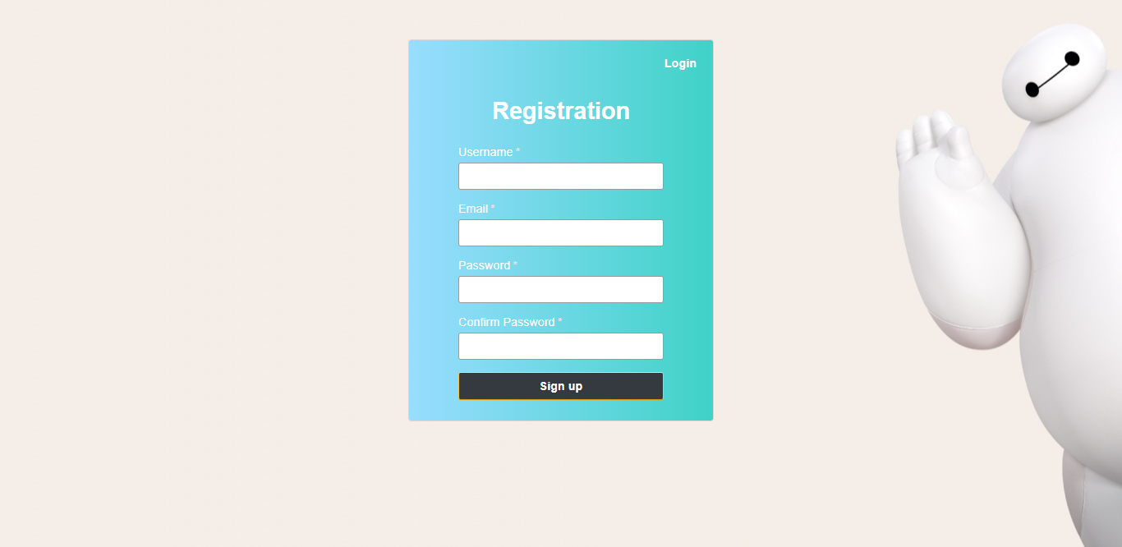
Registration Page

Slide 9
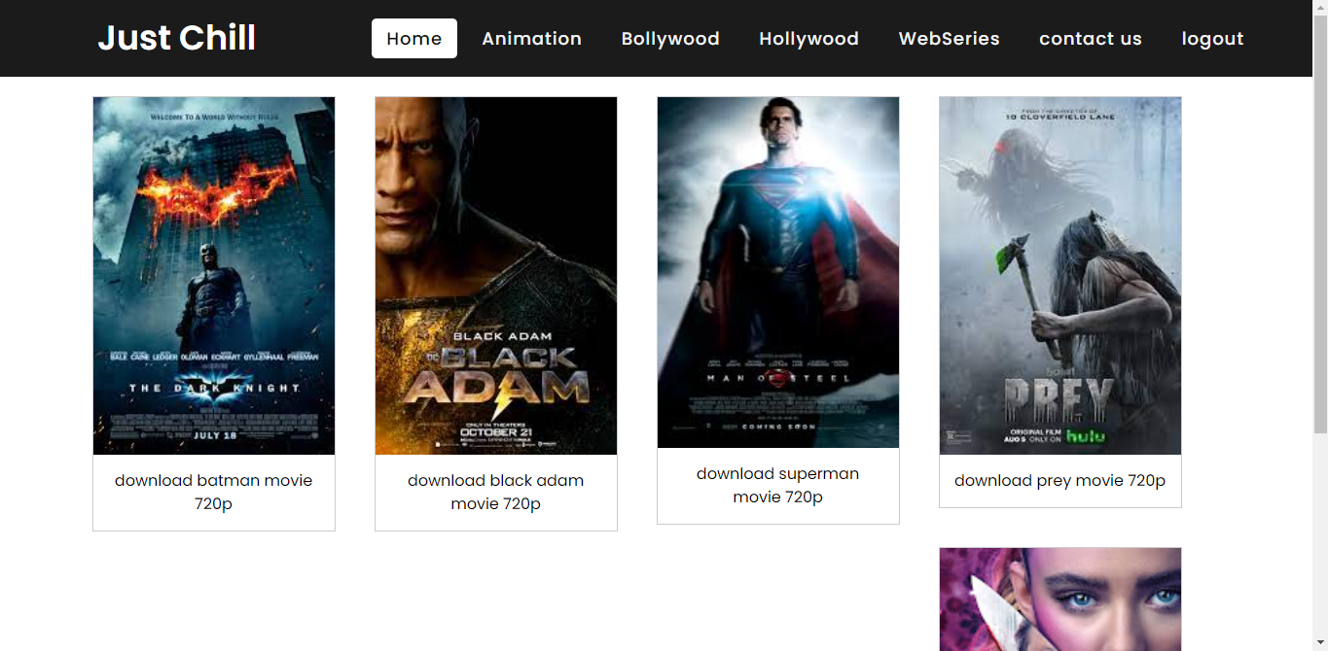
Home Page

Slide 10
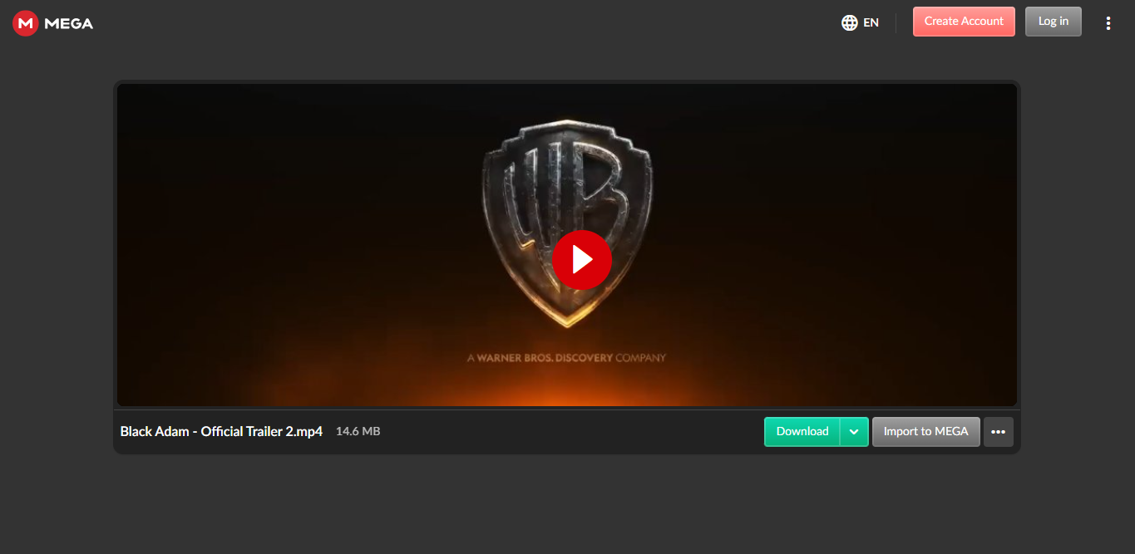
Downloading and Streaming page

Slide 11
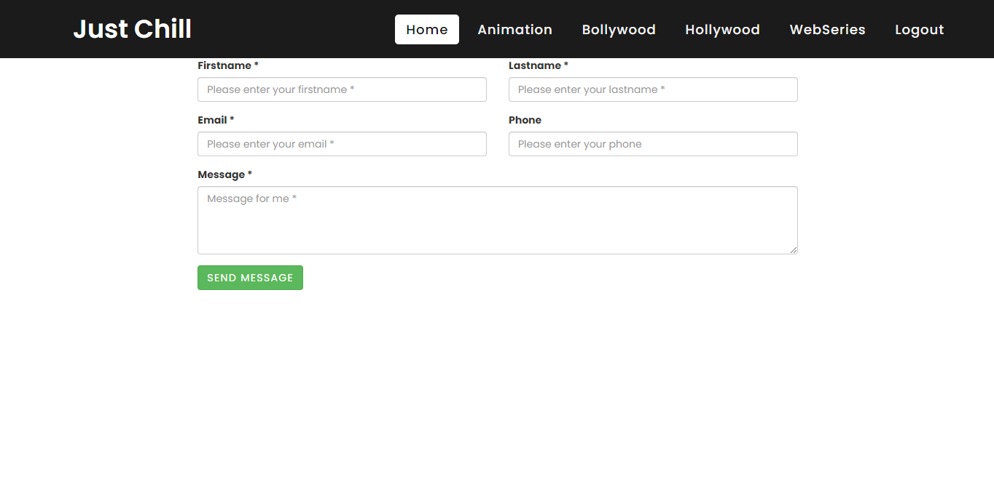
Contact us Page

Slide 12
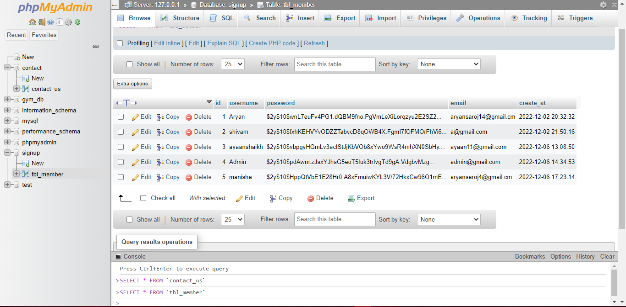
Register Backend

Slide 13
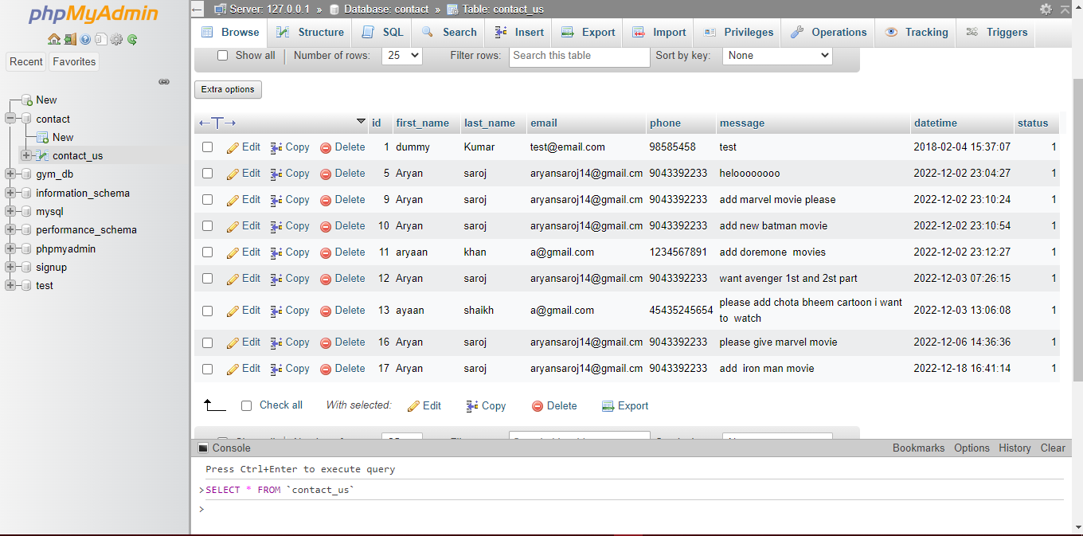
Contact Backend

Slide 14
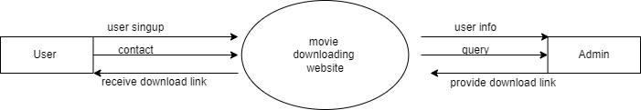
Data Flow Diagram

Slide 15
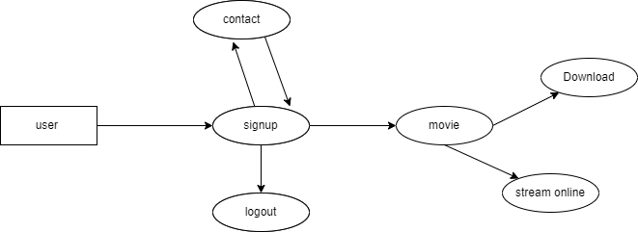
First Level DFD

Slide 16
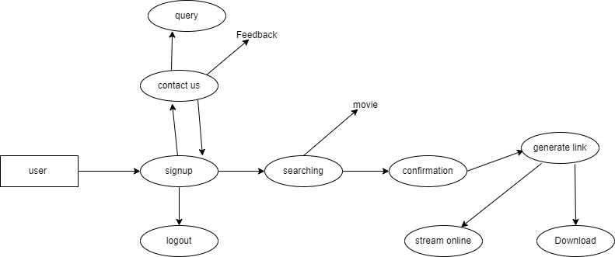
Second level DFD

Slide 17
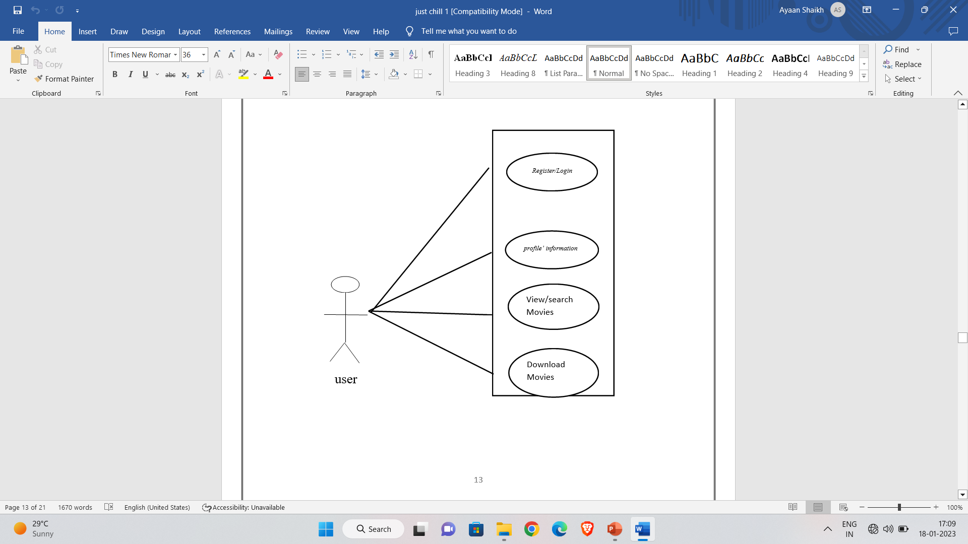
Use Case Diagram

Slide 18
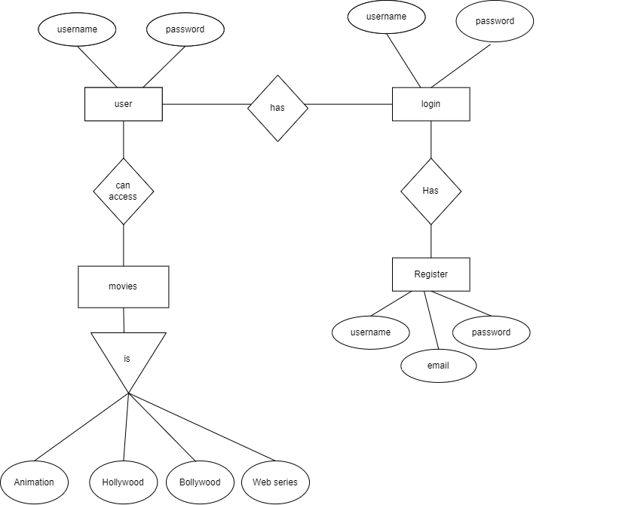
ER Diagram

Slide 19
Conclusion
The “MOVIE DOWNLOAD WEBSITE” is successfully designed and developed to fulfilling the necessary requirements, as identified in the requirements analysis phase, such as the system is very much friendly, form level validation and field level validation are performing very efficiently. The new computerized system was found to be much fast and reliable and user friendly then the existing system, the system has been designed and developed step and tested successfully. It eliminates the human error that are likely to creep in the kind of working in which a bulk quantity of data and calculation as to be processed . The system result s in quick retrieval of information that is very vital for the progress any organization. Cost is minimized in case of stationary. Burden of manual work is reduced as whenever transaction takes place, there is no need to record it in many places manually.

Slide 20
Thank you..!

